Slide 1
Lecture 8 Relational Database Design Purpose & First Normal Form
Good Design
Atomic
Dependencies
BCNF
3rdNF
MVDs
Design Process
United International College

Slide 2
Outline
Good Design
Atomic
Dependencies
BCNF
3rdNF
MVDs
Design Process
Features of Good Relational Design
Atomic Domains and First Normal Form
Functional Dependency Theory
BCNF
3rd Normal Form
Multivalued Dependencies and Decomposition
Database-Design Process

Slide 3
What is a good Design?
Good Design
Atomic
Dependencies
BCNF
3rdNF
MVDs
Design Process
Usually, a good design allows us to
retrieve information easily,
obtain all constraints,
minimize redundancies, and
have no ambiguous.
This is accomplished systematically by using normal forms.

Slide 4
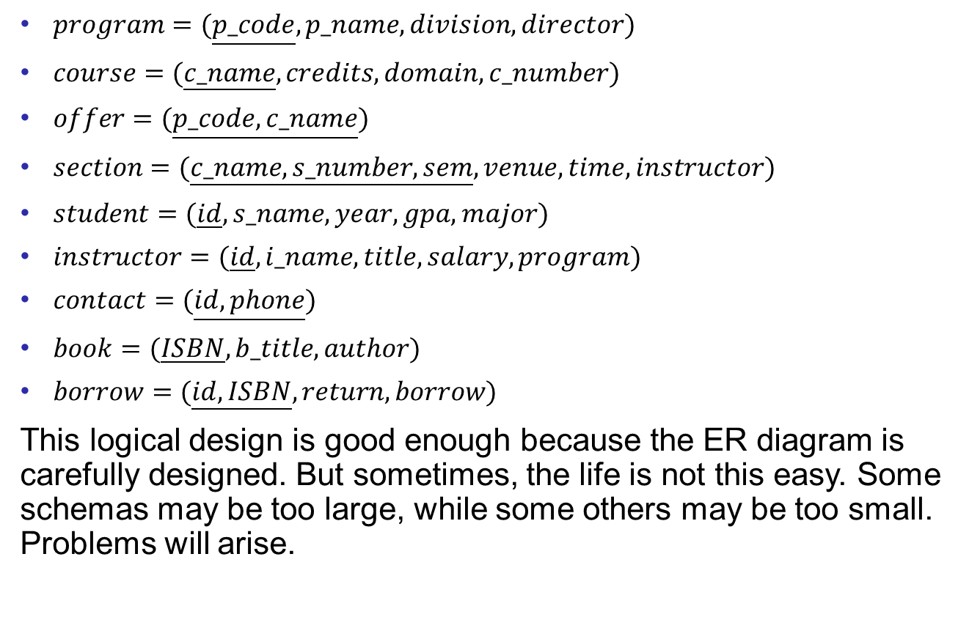
The UIC database Schema
Good Design
Atomic
Dependencies
BCNF
3rdNF
MVDs
Design Process
$program=(\underline{p_code},p_name,division,director)$
$course=(\underline{c_name},credits,domain,c_number)$
$offer=(\underline{p_code,c_name})$
$section=(\underline{c_name,s_number,sem},venue,time,instructor)$
$student=(\underline{id},s_name,year,gpa,major)$
$instructor=(\underline{id},i_name,title,salary,program)$
$contact=(\underline{id,phone})$
$book=(\underline{ISBN},b_title,author)$
$borrow=(\underline{id,ISBN},return,borrow)$
This logical design is good enough because the ER diagram is carefully designed. But sometimes, the life is not this easy. Some schemas may be too large, while some others may be too small. Problems will arise.

Slide 5
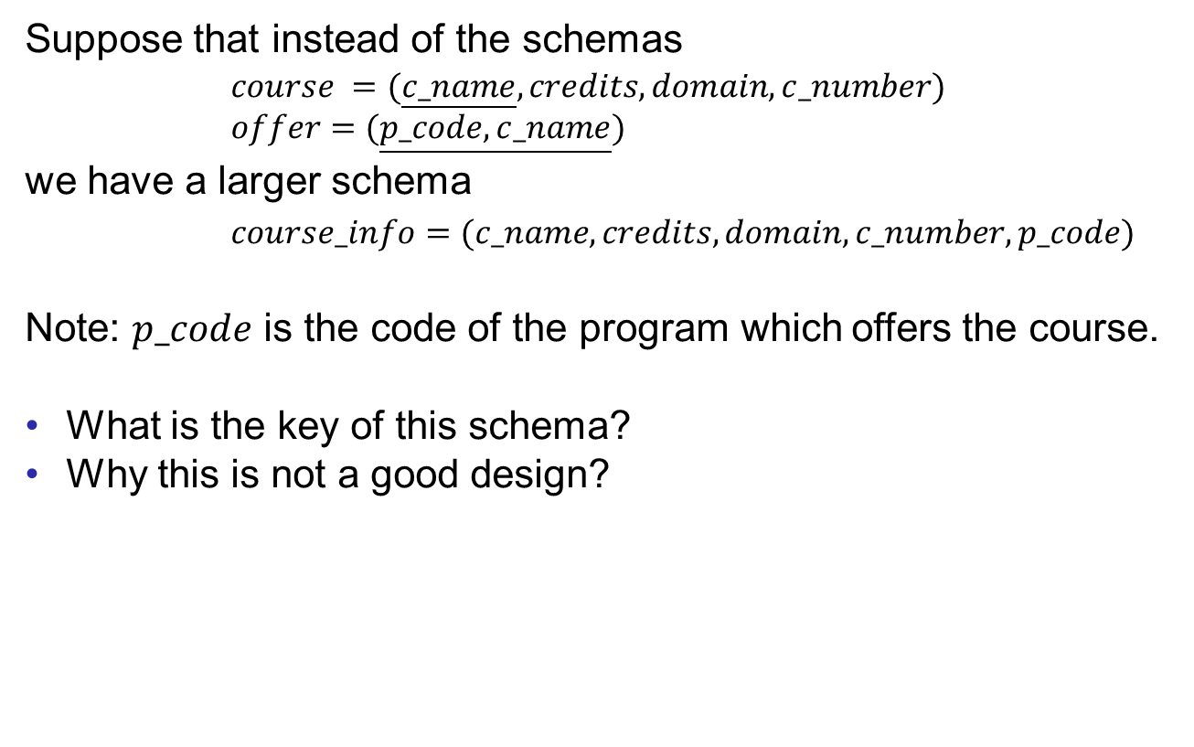
Larger Schemas?
Good Design
Atomic
Dependencies
BCNF
3rdNF
MVDs
Design Process
Suppose that instead of the schemas
$course =(\underline{c_name},credits,domain,c_number)$
$offer=(\underline{p_code,c_name})$
we have a larger schema
$course_info=(c_name,credits,domain,c_number,p_code)$
Note: $p_code$ is the code of the program which offers the course.
What is the key of this schema?
Why this is not a good design?

Slide 6
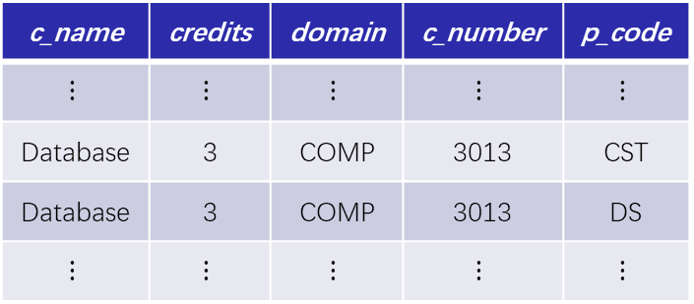
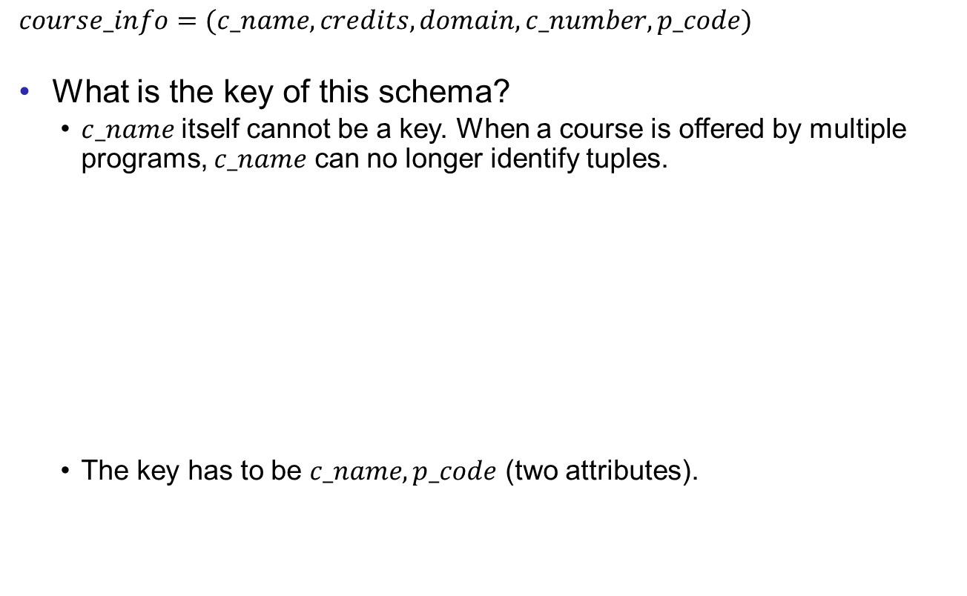
Larger Schemas?
Good Design
Atomic
Dependencies
BCNF
3rdNF
MVDs
Design Process
$course_info=(c_name,credits,domain,c_number,p_code)$
What is the key of this schema?
$c_name$ itself cannot be a key. When a course is offered by multiple programs, $c_name$ can no longer identify tuples.
The key has to be $c_name,p_code$ (two attributes).
c_name | credits | domain | c_number | p_code
$$⋮$$ | $$⋮$$ | $$⋮$$ | $$⋮$$ | $$⋮$$
Database | 3 | COMP | 3013 | CST
Database | 3 | COMP | 3013 | DS
$$⋮$$ | $$⋮$$ | $$⋮$$ | $$⋮$$ | $$⋮$$

Slide 7
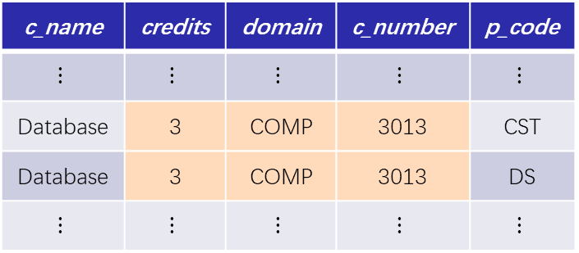

Larger Schemas?
Good Design
Atomic
Dependencies
BCNF
3rdNF
MVDs
Design Process
$course_info=(c_name,credits,domain,c_number,p_code)$
Why this is not a good design?
From the example, we see redundancy occurs.
The reason is that $credits,domain,c_number$ are decided by the course, but not by the program which offers the course.
c_name | credits | domain | c_number | p_code
$$⋮$$ | $$⋮$$ | $$⋮$$ | $$⋮$$ | $$⋮$$
Database | 3 | COMP | 3013 | CST
Database | 3 | COMP | 3013 | DS
$$⋮$$ | $$⋮$$ | $$⋮$$ | $$⋮$$ | $$⋮$$

Slide 8
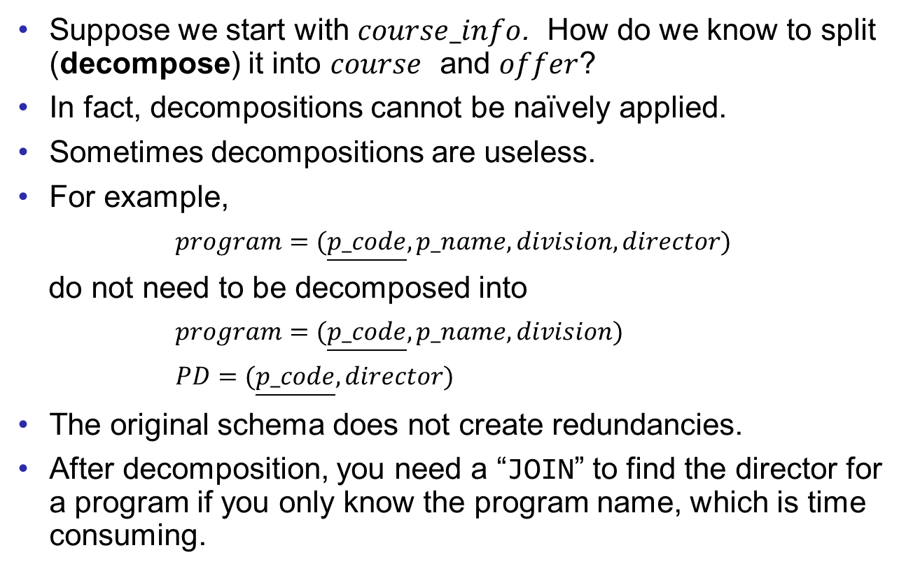
What About Smaller Schemas?
Good Design
Atomic
Dependencies
BCNF
3rdNF
MVDs
Design Process
Suppose we start with $course_info$. How do we know to split (decompose) it into $course$ and $offer$?
In fact, decompositions cannot be naïvely applied.
Sometimes decompositions are useless.
For example,
$program=(\underline{p_code},p_name,division,director)$
do not need to be decomposed into
$program=(\underline{p_code},p_name,division)$
$PD=(\underline{p_code},director)$
The original schema does not create redundancies.
After decomposition, you need a “JOIN” to find the director for a program if you only know the program name, which is time consuming.

Slide 9

What About Smaller Schemas?
Good Design
Atomic
Dependencies
BCNF
3rdNF
MVDs
Design Process
Sometimes naïve decompositions create inconsistency.
For example,
$student=(\underline{id},s_name,year,gpa,major)$
is decomposed into (pay attention to the keys)
$stu=(\underline{id},s_name)$
$stuinfo=(\underline{s_name,year,gpa,major})$
id | s_name | year | gpa | major
⋮ | ⋮ | ⋮ | ⋮
1001000654 | Dave | 5 | 2.01 | TESL
1701026104 | Dave | 1 | 3.41 | CST
⋮ | ⋮ | ⋮ | ⋮
id | s_name
⋮ | ⋮
1001000654 | Dave
1701026104 | Dave
⋮ | ⋮
s_name | year | gpa | major
⋮ | ⋮ | ⋮
Dave | 5 | 2.01 | TESL
Dave | 1 | 3.41 | CST
⋮ | ⋮ | ⋮

Slide 10

What About Smaller Schemas?
Good Design
Atomic
Dependencies
BCNF
3rdNF
MVDs
Design Process
Suppose we want to find the major of the student by IDs, we have to join $stu$ and $stu_info$. This creates some fake data.
id | s_name
⋮ | ⋮
1001000654 | Dave
1701026104 | Dave
⋮ | ⋮
s_name | year | gpa | major
⋮ | ⋮ | ⋮
Dave | 5 | 2.01 | TESL
Dave | 1 | 3.41 | CST
⋮ | ⋮ | ⋮
JOIN
id | s_name | year | gpa | major
⋮ | ⋮ | ⋮ | ⋮
1001000654 | Dave | 5 | 2.01 | TESL
1001000654 | Dave | 5 | 2.01 | CST
1701026104 | Dave | 1 | 3.41 | TESL
1701026104 | Dave | 1 | 3.41 | CST
⋮ | ⋮ | ⋮ | ⋮

Slide 11
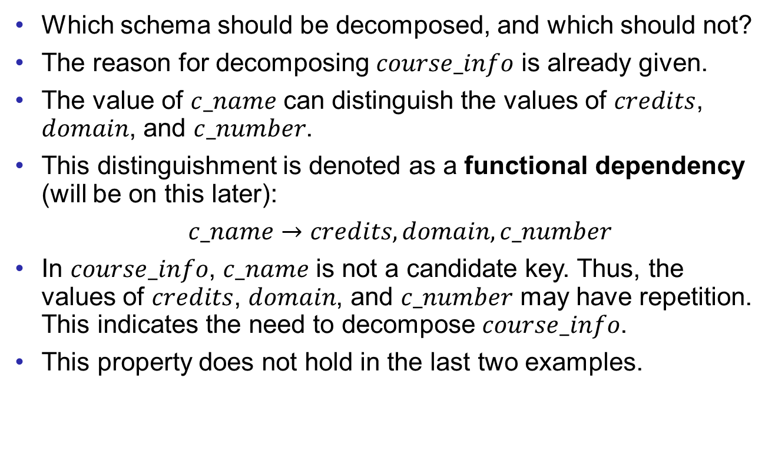
What About Smaller Schemas?
Good Design
Atomic
Dependencies
BCNF
3rdNF
MVDs
Design Process
Which schema should be decomposed, and which should not?
The reason for decomposing $course_info$ is already given.
The value of $c_name$ can distinguish the values of $credits$, $domain$, and $c_number$.
This distinguishment is denoted as a functional dependency (will be on this later):
$c_name→credits,domain,c_number$
In $course_info$, $c_name$ is not a candidate key. Thus, the values of $credits$, $domain$, and $c_number$ may have repetition. This indicates the need to decompose $course_info$.
This property does not hold in the last two examples.

Slide 12
Outline
Good Design
Atomic
Dependencies
BCNF
3rdNF
MVDs
Design Process
Features of Good Relational Design
Atomic Domains and First Normal Form
Functional Dependency Theory
BCNF
3rd Normal Form
Multivalued Dependencies and Decomposition
Database-Design Process

Slide 13
First Normal Form
Good Design
Atomic
Dependencies
BCNF
3rdNF
MVDs
Design Process
A domain is atomic if its elements are considered to be indivisible units.
Examples of non-atomic domains:
Set of names, composite attributes
Identification numbers like CS101, that can be broken up into parts.
A relational schema R is in first normal form if the domains of all attributes of R are atomic.
Non-atomic values complicate storage and encourage redundant (repeated) storage of data.

Slide 14
First Normal Form
Good Design
Atomic
Dependencies
BCNF
3rdNF
MVDs
Design Process
Atomicity is actually a property of how the elements of the domain are used.
Example: Strings would normally be considered indivisible.
Suppose that students are given roll numbers which are strings of the form CS0012 or EE1127.
If the first two characters are extracted to find the department, the domain of roll numbers is not atomic.
Doing so is a bad idea: leads to the encoding of information in application program rather than in the database.
Database users have to know the encoding before developing applications.

Slide 15
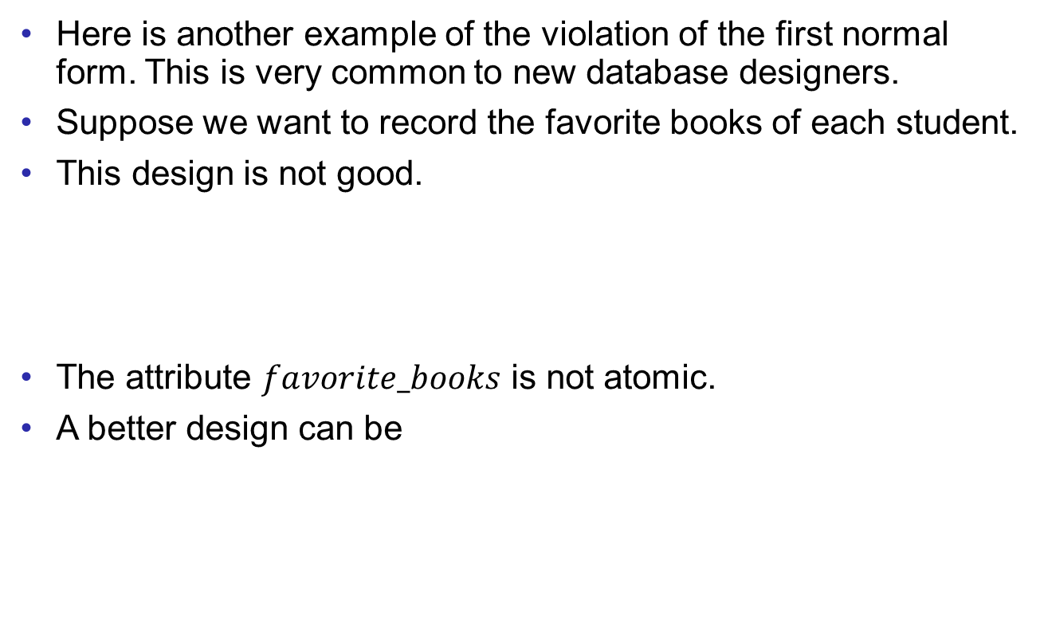
First Normal Form
Good Design
Atomic
Dependencies
BCNF
3rdNF
MVDs
Design Process
Here is another example of the violation of the first normal form. This is very common to new database designers.
Suppose we want to record the favorite books of each student.
This design is not good.
The attribute $favorite_books$ is not atomic.
A better design can be
id | s_name | favorite _books
1001000654 | Dave | Three body, MacBeth, Database
1701026104 | Steven | Three Body
⋮ | ⋮ | ⋮
id | s_name | favorite _book
1001000654 | Dave | Three body
1001000654 | Dave | MacBeth
1001000654 | Dave | Database
1701026104 | Steven | Three Body
⋮ | ⋮ | ⋮

Slide 16
End of Lecture 8
Good Design
Atomic
Dependencies
BCNF
3rdNF
MVDs
Design Process

